Slide 1
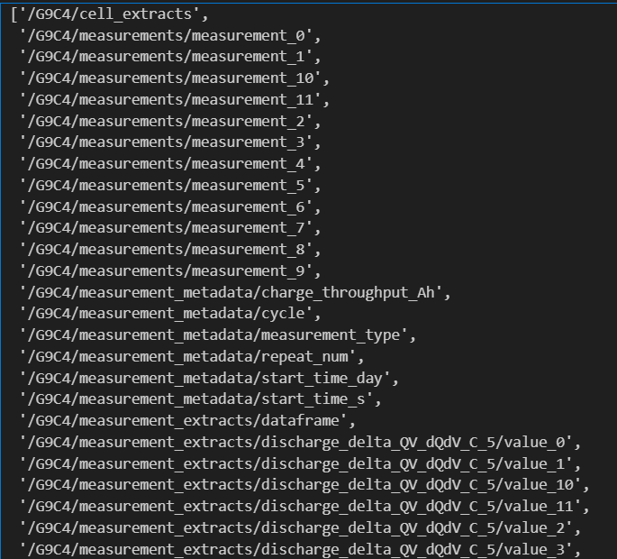
‘cell_extracts’ = Targets, like ‘weeks to failure’
in a dataframe with 1 column, indexed by
the extract name
‘measurements’ =
Dataframes of raw measurement data
(current, voltage, time, step #, ….)
‘measurement_metadata’ =
chronological variables (time of each
measurement, cycle count, ….) AND
a list of the measurement types ([‘RPT’,
‘Aging cycle’, ‘Aging cycle’, ‘RPT’, …])
‘measurement_extracts/dataframe’ =
all low-dimensional extracts (discharge
capacity at cycle [1,2,3,…]) in a dataframe
of shape M measurements x N extracts
‘measurement_extracts/…’ = high
dimensional extracts (delta QV curves, …)
in a dataframe

Slide 2
Dataset Object Structure
BatteryData object
  metadata (dictionary)
  battery_data (list of CellData objects)
    cell_metadata
    measurements (list of EchemMeasurement objects)
      extracts (dictionary)

